Slide 1

Chicago Resource Analysis
Jeremy Marino

Slide 2
What is this Project About?
What are the Project Goals?
The status of communities inside the of Chicago based on citizen polled data. By using information from the GeoPandas datasets, statistics about these communities can be uncovered and understood in a new context.
To analyze the different socio-economic factors that affect Chicago communities, how they correlate with one another, and what implications they have for greater American population.

Slide 3
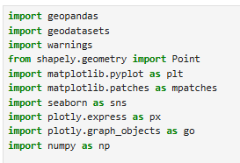
Tools and Libraries
I used Python in a Jupyter Notebook environment for convenience in step-by-step data analysis
Python libraries used:
Standard data analysis libraries for managing, cleaning, and evaluating data: numpy, pandas
Standard data presentation libraries for static plots: matplotlib, seaborn
Machine learning libraries for preprocessing/modeling: sklearn
Geographic Information System (GIS) specific libraries for map plotting: plotly, geopandas, geodatasets

Slide 4
Data Exploration
This project uses multiple datasets from the GeoDataSet/GeoPandas libraries. Below are their links with brief explanations:
Chicago Community Area Population Dataset: https://geodacenter.github.io/data-and-lab//commpop/
Provides basic community information and mapping coordinates for each community to be plotted
Chicago Health Dataset: https://geodacenter.github.io/data-and-lab//comarea_vars/
Has health information per community (statistics in cancer, pregnancy, stroke statistics, etc)
Gives community demographic information (race, age, gender)
Crime and poverty statistics
GeoPandas Data:
Used to find liquor and grocery store locations within Chicago’s communities

Slide 5
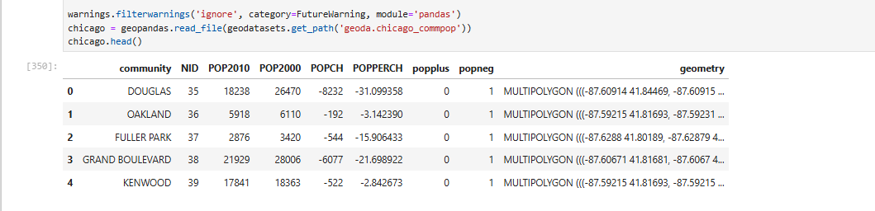
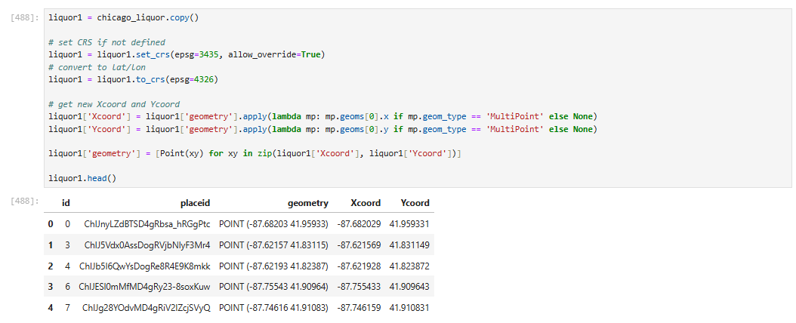
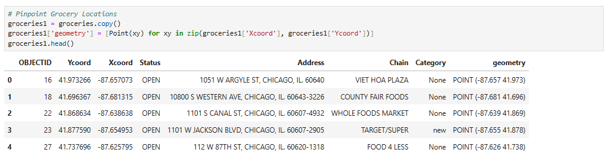
Data Exploration
Chicago Community Area Population Dataset w/ Liquor and Grocery Data
Pull data from APIs
Locate Chicago-centered liquor and grocery stores
Convert coordinate data to usable geometry

Slide 6
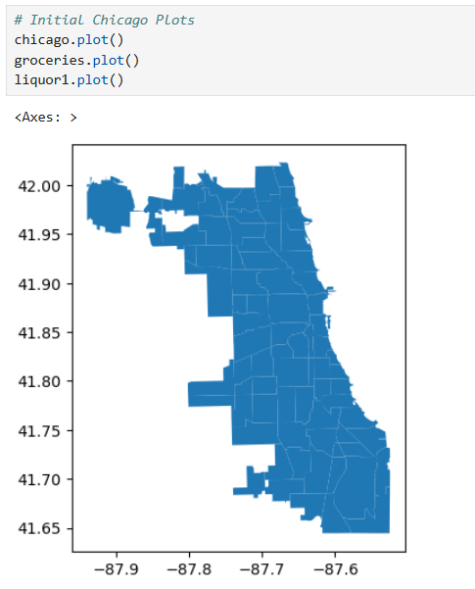
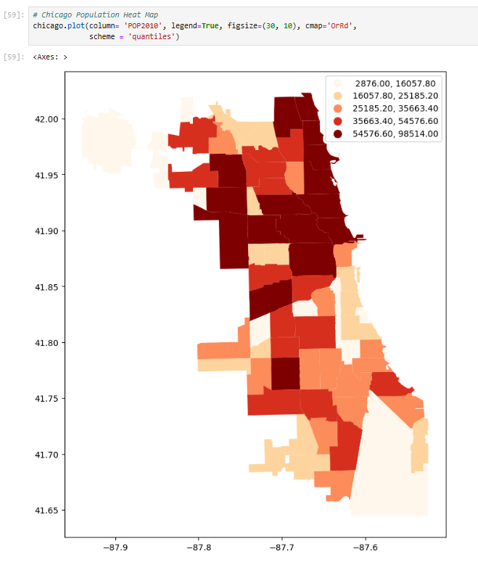
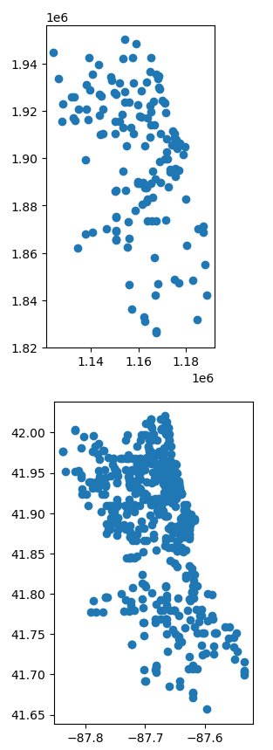
Plotting Initial Maps
Chicago Community Area Population Dataset w/ Liquor and Grocery Data
Use geospatial data to plot out initial Chicago map
Plotting grocery/liquor locations respectively in the area
Created initial heat map to get a better understanding of the population distribution

Slide 7
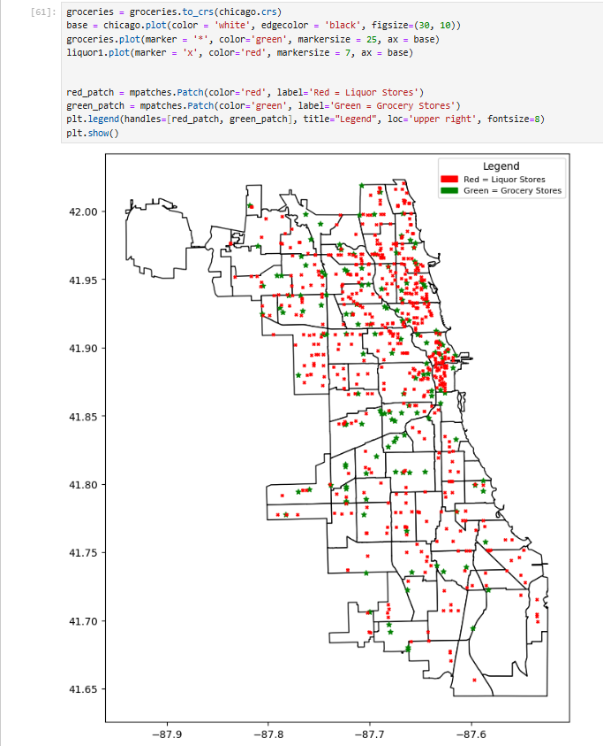
Putting it Together
Chicago Community Area Population Dataset w/ Liquor and Grocery Data
The distribution of grocery stores is much sparser around the least dense, more impoverished areas on the South Side
Takeaways:
Generally, low-income/high crime areas such as the South Side have food deserts (i.e. a lack of grocery stores in a particular area) with a higher volume of liquor stores.
This forces people of those areas to depend on fast food restaurants and corner stores to find food
Droughts of accessible foods and surplus of liquor stores often forces residents into cycles poor health and alcoholism

Slide 8
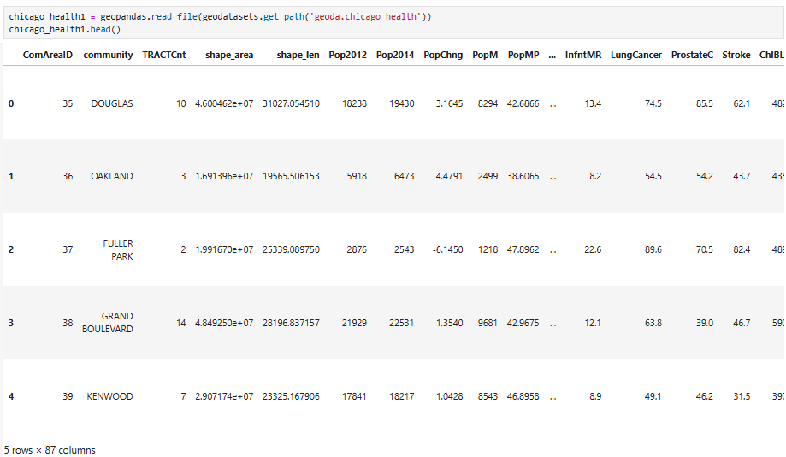
More Data Exploration
Chicago Health Dataset w/ Liquor and Grocery Data
The Chicago Health dataset is a larger dataset that has 87 features for all 77 Chicago communities.
Before starting analysis, it is important to clean redundant information, check for idiosyncrasies, and aggregate useful features that are left out of the data.

Slide 9
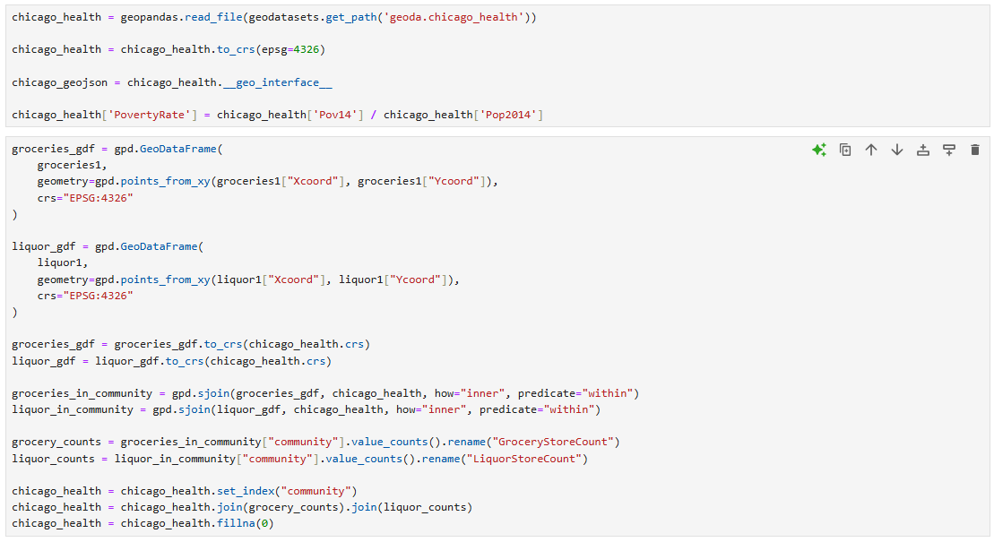
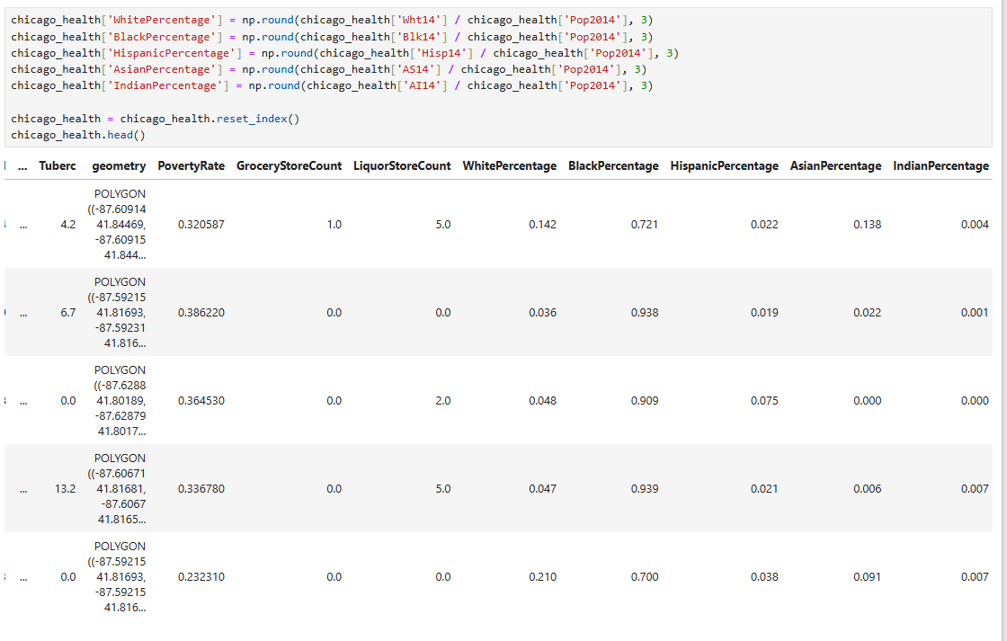
Aggregate Features
Chicago Health Dataset w/ Liquor and Grocery Data
Added Features
PovertyRate - Simple percentage to see what areas have the highest poverty rates relative to population
Grocery/LiquorStoreCount - Count of the number of stores in each community based on community borders
RacePercentage - Simple demographic percentage per race in communities relative to population

Slide 10
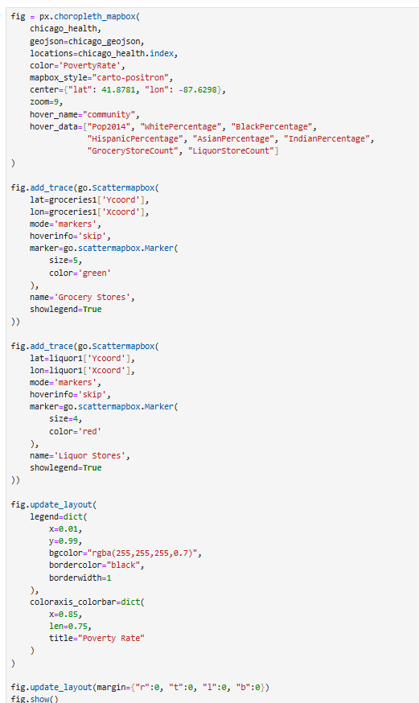
Inactive Map
Chicago Health Dataset w/ Liquor and Grocery Data
Allows hover functionally based on given aggregates
Overlaid with prior grocery and liquor data
Uses PovertyRate as a heat map to distinguish different area’s economic status

Slide 11
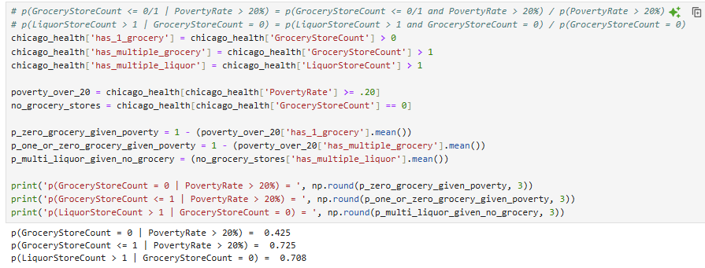
Conditional Probability
Chicago Health Dataset w/ Liquor and Grocery Data
As seen in the rates above, it supports the claim that impoverished communities have little access to healthy food options as stated before, and that the abundance of corner markets such as liquor stores take precedent in many community's diets.
Above is the conditional probability given a community's poverty rate is greater than 20% (America's poverty rate at the time was 14.8%) that they have no grocery stores, at 42.5%, or less than one grocery store, at 72.5%, in their communities respectively.
This corresponds with the probability a community has multiple liquor stores given it has not grocery stores, at 70.8%.

Slide 12
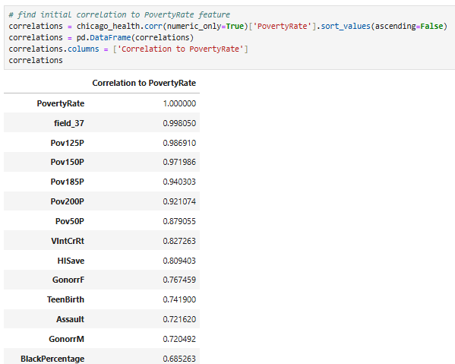
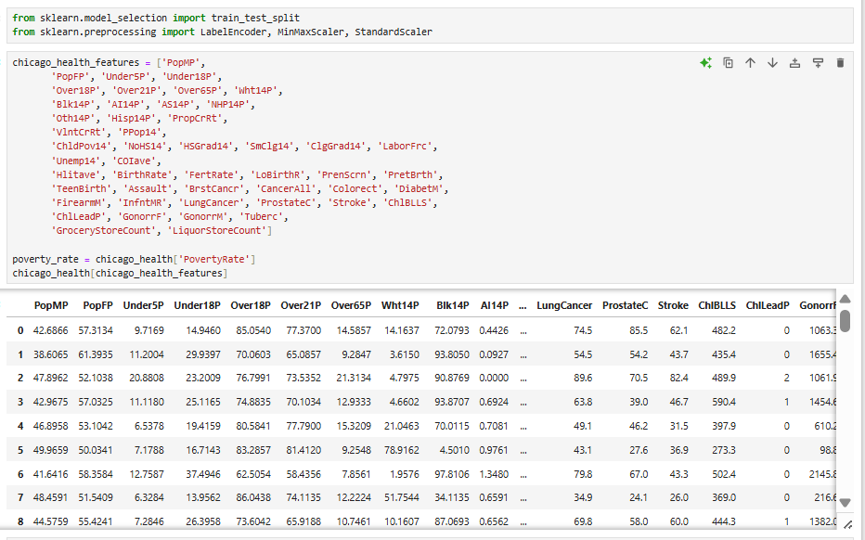
Correlation and Model Preparation
Chicago Health Dataset w/ Liquor and Grocery Data
The next step is to prepare data for regression to find the most prominent features within the dataset that correlation with PovertyRate.
This will be done by analyzing initial correlation and using lasso regression, a machine learning model for feature prediction.
To the right is the removal of irrelevant, repeated data, and non-proportional values where possible that would take away from the important findings of the model.
For example, obviously the number of people with income below 50% of the poverty rate is correlated with the aggregate poverty rate, and would drown out interesting correlations.

Slide 13
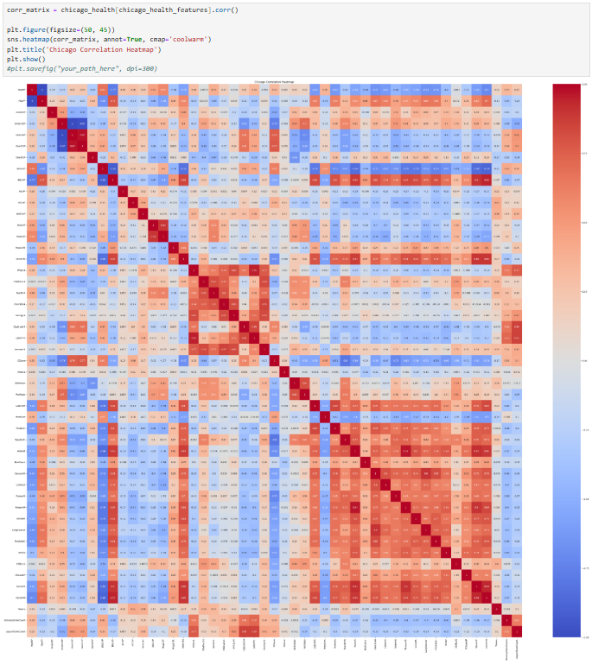
Correlation Matrix
Chicago Health Dataset w/ Liquor and Grocery Data
Here using a correlation matrix can help visually identify what features correlate/do not correlate with other features.
Prevalent Findings:
The correlation between the black population and negative health conditions is very high (the relationship between gonorrhea and the black male/female populations, in particular, is shocking at a combined 93% correlation rate)
The correlation between health issues in the black vs the white population seems to have an inverse relationship, as all negative conditions (gonorrhea, stroke, lung cancer, etc) positively correlate strongly with the black population and negatively correlate strongly with the white population. The opposite is true for the correlation between each population and prenatal care beginning in the first trimester.
A child in poverty has a very strong correlation with not going to high school and higher education
The white population has a positive correlation to both grocery and liquor store counts, while the black population has a negative correlation.

Slide 14
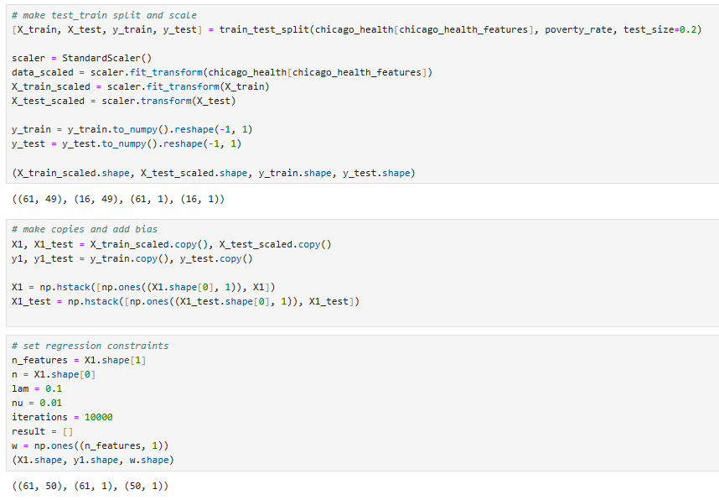
Model Preprocessing
Chicago Health Dataset w/ Liquor and Grocery Data
Create a test/train split of the filter data (20/80% respectively)
Use Standard Scaler to normalize data to prevent overfitting (i.e. large numeric values drowning out smaller numeric features)
Create copies and add bias columns (to account for over/underestimates in the model)
Set regression constraints for run time and adjust as necessary

Slide 15
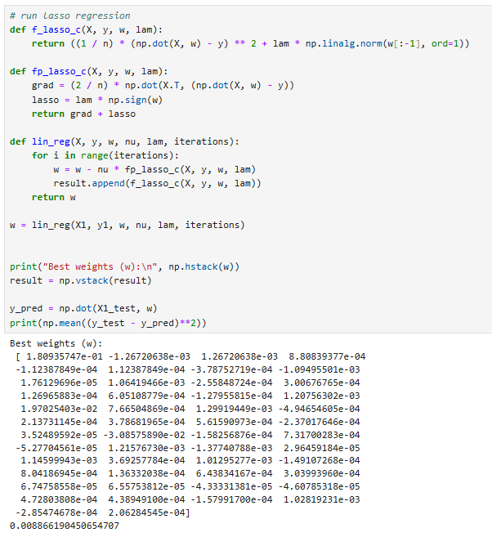
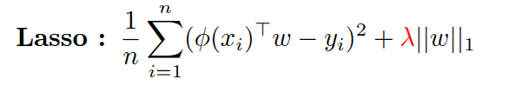

Lasso Regression Running/Results
Chicago Health Dataset w/ Liquor and Grocery Data
Lasso Regression:
Uses the loss function (mean square error) + regularization function (order 1 normalization) to gain smooth results
Iterates over the function over and over as it approaches 0 error
Weight matrix (w), gives respective weights to each feature that makes an accurate prediction as to what the result will be.
By splitting the data, the test portion is used to determine the error rate of the weights (in this case, 0.89%)

Slide 16
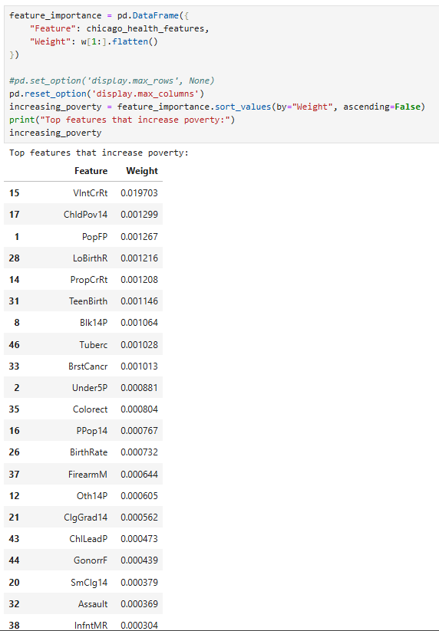
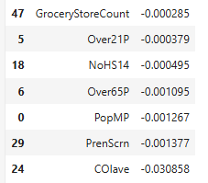
Feature Importance
Chicago Health Dataset w/ Liquor and Grocery Data
It appears many of the features commonly associated with poverty are the most relevant to the percentage of people below the poverty line (violent/property crime, birth rates/teen birth, lingering health issues, etc).
These features are most associated with the black population and compound on each other making them congruent problems when discussing socio-economic issues revolving poverty and race.

Slide 17
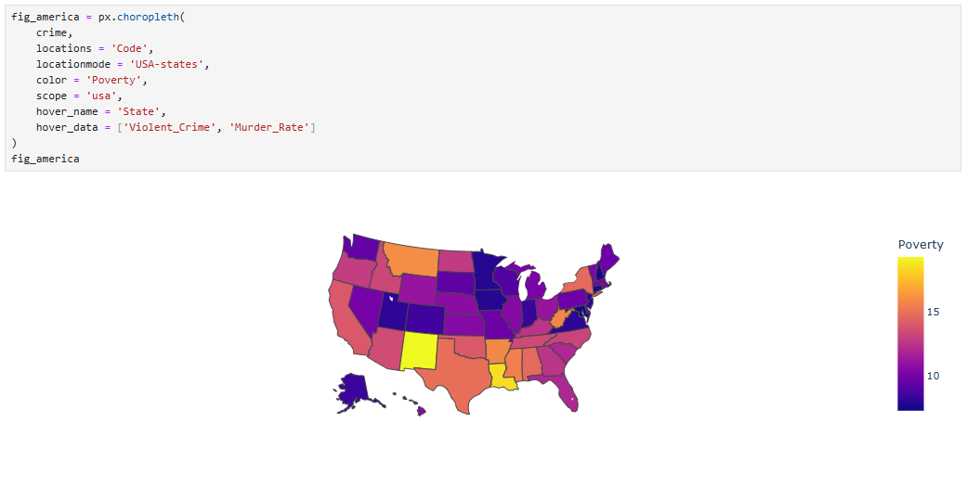
Conclusion and General Thoughts
While none of these finding may come as a shock to the average American, it is vital that data is collected to find and diagnose larger issues such as this.
While there is no simple solution to alleviating poverty and race inequality, arming people with insights into the world around them is necessary in developing answers to lingering societal problems such as this.
Interestingly, Illinois as a state is on the lower end of poverty in the US (although Chicago being a major city is among the highest)

Slide 18
Considerations, Future Projects, etc
Considerations for this analysis:
Data is via a self-reported 2014 survey based on Chicago demographics
The sample-size (i.e. the 77 Chicago communities) is generally a small sample size for training a regression model
Some data used seems inaccurate (for example, almost all per capita income statistics are in the 100k range, which is incorrect)
Expansion Plans:
More data sets (interest in seeing how these findings relate to other communities/how accurate regression model is with exterior data)
Expand to different cities (what other areas communities may be interesting to analyze in comparison to Chicago)
New Machine Learning Models (get data insights and predictions)
Other Current Projects:
Database Design and AI Integration
Redesigning a large database in relational SQL database for my family’s small business
Using AI tools to help manage the data, queries, and customer demands
NBA ‘Hot Hand’ Analysis
Trying to answer the question if there is any validity in the idea of players getting ‘hot’ or ‘cold’

Slide 19
Thank You!
Questions?

